Slide 1
Final project
Group 1
You li, chang yu, songzhe zhang

Slide 2
Pre-Process
The data pro-process includes related material adding and data cleaning. In order to promote the precise of our model. The content list below will describe how we add weather, address, workdays together in to our final dataset.

Slide 3
Pre-Process
The data pro-process includes related material adding and data cleaning. In order to promote the precise of our model. The content list below will describe how we add weather, address, workdays together in to our final dataset.
we gather the trips of Uber from January to July with the trip’s location

Slide 4
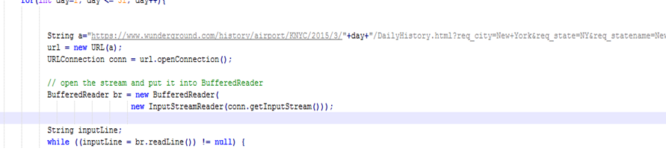
Pre-Process
To get the related weather data, we try to use the weather API from www.wundergound.com. However, the price to get the history is about 3000 dollars. Obviously, it’s impossible for us to purchase so much money for so precious data. So we

Slide 5
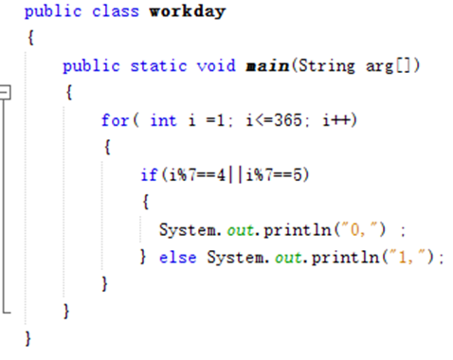
Pre-Process
The data pro-process includes related material adding and data cleaning. In order to promote the precise of our model. The content list below will describe how we add weather, address, workdays together in to our final dataset.

Slide 6
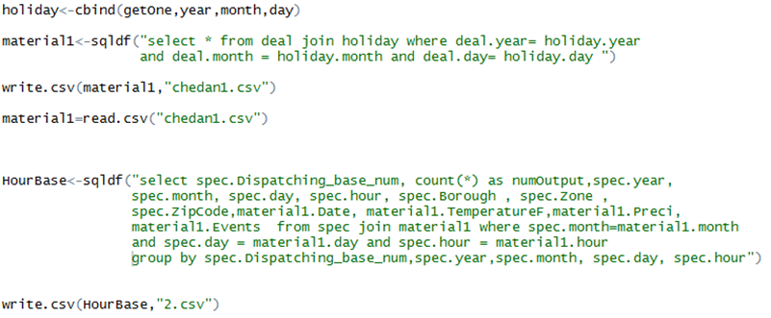
Pre-Process
Through combining the data in the scope of areas, we get the dataset which can be used to predict the trend to Uber trips in hours, days, months. The model for servicing drivers end is mainly developed from these data sets.

Slide 7
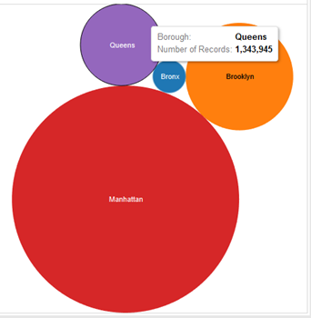
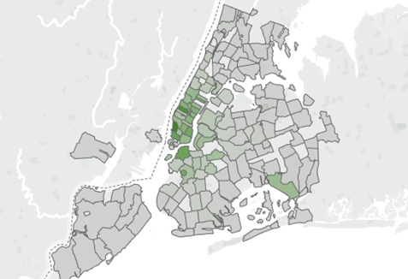
Visualization Analytic
The distribution of Uber trips in different zip area
The graph will show the number of Uber trips from the darker or lighter of the color in these zips. We can easily tell that the number of trips is affect by its area. So it’s necessary to take the variables zip code in to consideration.

Slide 8
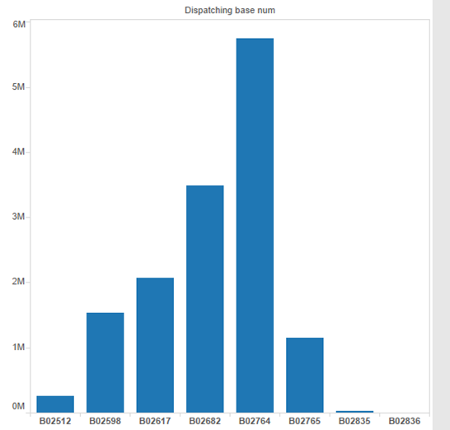
Visualization Analytic
Different Dispatch Base undertake different levels of tasks.
As what you can see, the different number of dispatch’s tasks is totally different, it is necessary to make them into categories before we cast them in to analysis.

Slide 9
Visualization Analytic
The weather, workday, temperature and other variables also build through tableau.
https://public.tableau.com/views/bg/Story1?:embed=y&:display_count=yes&:showTabs=y

Slide 10
Model
Problem Statement
Predict numeric value
Regression Problem
Algorithm
Linear Regression, Bayesian linear Regression, Boosted Decision Tree, Decision Forest Tree

Slide 11
Model Use-cases
Hourly-Zip Code
Daily - Zip Code
Hourly - Base
Daily - Base

Slide 12
Model Evaluation
Use Root Mean Square Error to Evaluate each model.
Model Hourly- zipCode
Model Daily - ZipCode
 | Linear Regression | Boosted Decision Tree | Decision Forest Tree | Bayesian Linear Regression
Root Mean Squared Error | 25.35 | 23.94 | 24.16 | 25.43
 | Linear Regression | Boosted Decision Tree | Decision Forest Tree | Bayesian Linear Regression
Root Mean Squared Error | 268.40 | 260.26 | 290.73 | 268.59

Slide 13
Model evaluation
Model Hourly- Base
Model Daily - Base
 | Linear Regression | Boosted Decision Tree | Decision Forest Tree | Bayesian Linear Regression
Root Mean Squared Error | 268.40 | 260.26 | 290.73 | 268.59
 | Linear Regression | Boosted Decision Tree | Decision Forest Tree | Bayesian Linear Regression
Root Mean Squared Error | 735.87 | 625.34 | 685.73 | 736.46

